Slide 1
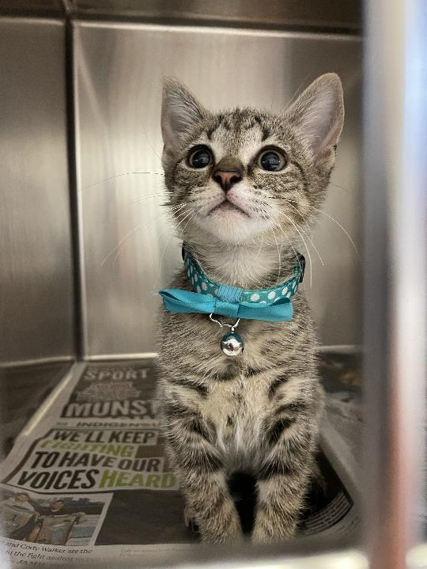


Australian Community Cat Program
2023 Mid-Year Report
September 2023
Jacquie Rand
BVSc (Melb), DVSc (Guelph), MANZCVS, Dip ACVIM (IM)
Emeritus Professor of Companion Animal Health, UQ
Executive Director & Chief Scientist
Australian Pet Welfare Foundation
info@petwelfare.org.au

Slide 2

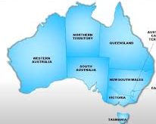

2023 Mid-Year Report: Community Cat Program
Major learnings in this year
2,604 cats desexed in Qld
(as of 22/09/2023)
Microtargeting desexing to locations where cats are most at risk of impoundment and euthanasia is critical to success.
Engagement of Animal Management Officers increases the effectiveness and efficiency of the program.
Engaging with the community to recruit Cat Ambassadors will be important for scaling Community Cat Programs up to quickly cover large urban areas.
Cat Ambassadors are the key to communicating with residents to identify owners and cat carers needing assistance with desexing, and helping with multiple tasks associated with the program.
This document provides an update of the progress of the Australian Community Cat Program, and a summary of the collective learning from all the sites, which would not have been possible without your support !!
I hope you like the new simpler format!
Stopped 7,500 kittens being born this year
Euthanasia decreased 57% - 85% over 18-24 months in CCP locations
Advocacy for CCPs in 3 state reviews of rehoming
Three scientific papers published or in press

Slide 3
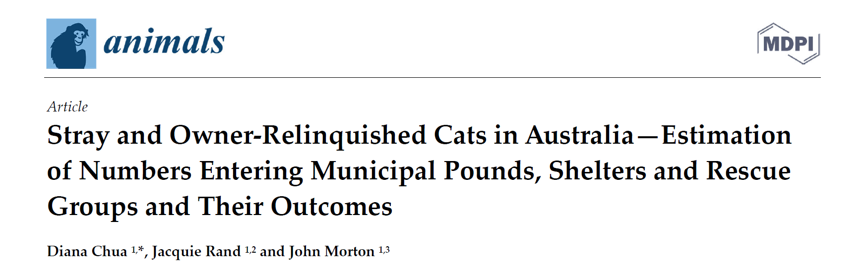
2023 Mid-Year Report: Community Cat Program
There is an URGENT need for Community Cat Programs
Published: Animals Journal 2023
Key findings in study
46% of cats and kittens entering council-managed pounds are killed.
A quarter of pounds in Victoria and NSW kill 67%-100% of cats and kittens.
Total admissions to pounds, shelters, and rescue groups = 79,615 cats (7.2/1000 humans).
Only 5% of cats are reclaimed by owners.
50,000 mostly healthy and treatable cats and kittens are killed each year in Australia
Councils operating their own pounds had nearly double the euthanasia rate (46%) compared to animal welfare organizations (25%).

Slide 4

2023 Mid-Year Report: Community Cat Program
One Welfare Scorecard for Australia’s Urban Cat Management
FAIL
How are we performing?
Animals
In Australia, 33% of cats and kittens entering pounds and shelters are killed. Australia’s worst councils kill 67%-100% of cats and kittens.
Humans
Negative mental health impacts to those caring for, and killing cats.
One Welfare
Aims to balance and optimize the wellbeing of animals, people and the environment
“…we just felt absolutely grief stricken. I cried like I'd lost all of my pets my whole life a million times over, because I didn't know exactly who had gone, who was left injured.”
FAIL
Environment
No environmental benefits—after killing 107,256 cats and kittens in NSW pounds, cat impoundments remained the same at 24,000 per year.
“I have seen so many people’s lives damaged by having to kill a never ending stream of kittens and cats”

Slide 5
2023 Mid-Year Report: Community Cat Program / Shelter Data – Intake Results
After desexing cats for 1.5 years in Redbank Plains (pop 24,349), in the following year (2022-23) we achieved a 30% reduction in intake from baseline. Over 900 cats (38 cats/1000 residents) have been desexed over 2.5 years.
In 2022-23, across all 3 target suburbs (population 38,000), intake dropped by 18% from baseline compared to a decrease of 1.6% in the non-target suburbs.

Slide 6
2023 Mid-Year Report: Community Cat Program / Shelter Data – Euthanasia Results
Mean Euthanasia = 60/yr
In 2022/23, target suburbs had a 65% reduction in euthanasia compared to 37% in non-target suburbs

Slide 7
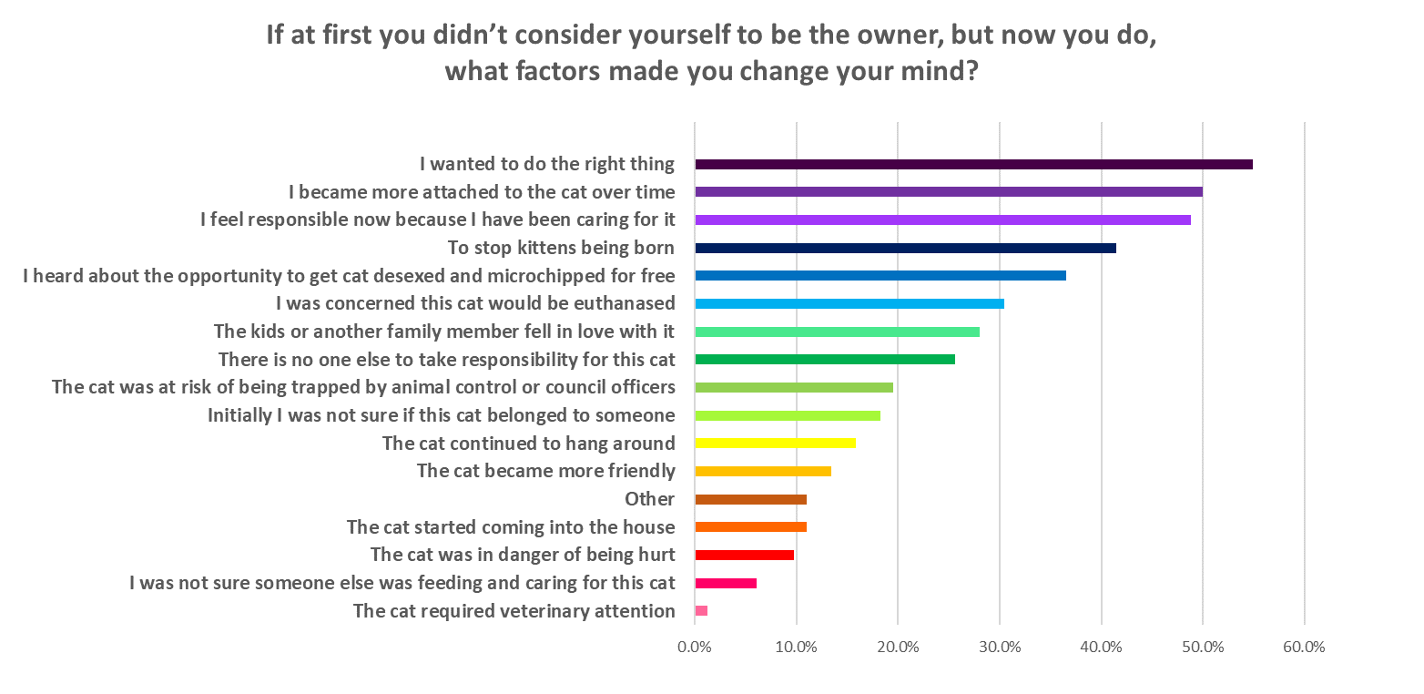
2023 Mid-Year Report: Community Cat Program / Ownership Data
When the cat first came into your life, did you regard yourself as the owner or were you just feeding or caring for this cat?
Owner = 88%; Carer/Just Feeding (Semi-owner) = 12%; (Number of respondents =676)
If at first you didn’t consider yourself to be the owner, but now you do, what made you change your mind? Choose up to 5 factors; (Number of respondents =82)
54%
50%
49%
42%
37%

Slide 8
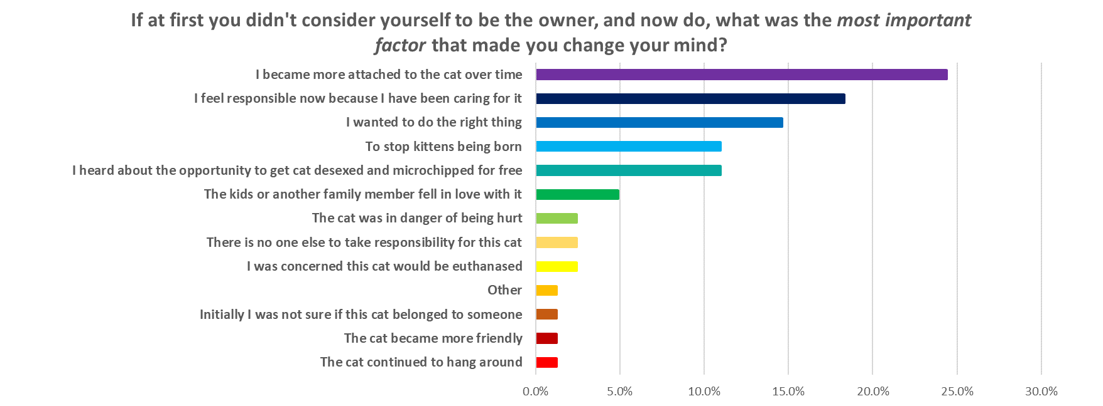
2023 Mid-Year Report: Community Cat Program / Ownership Data
If at first you didn’t consider yourself to be the owner, but now you do, what was the single most important factor that made you change your mind? (Number of respondents = 82)
24%
18%
15%
11%
11%

Slide 9
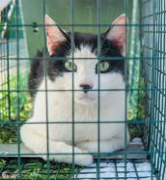
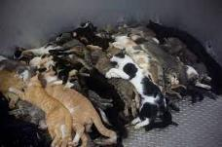

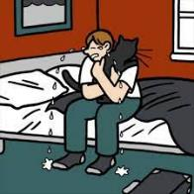
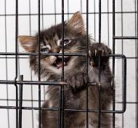


2023 Mid-Year Report: Community Cat Program- Key Findings from City of Banyule, Victoria (pop 130,00). :
Impacts of a local government funded free cat sterilization program for owned and semi-owned cats. In prep Cotterell et al,
Moderate-intensity program, microtargeted by AMOs in 3 problematic suburbs; low-intensity microtargeted over whole city.
Over 8 years, 35 cats desexed/1000 residents in 3 target suburbs (pop 13,445), 7 cats/1000 residents citywide
Desexing rate in 3 target suburbs averaged 4.3 cats desexed/1000 residents each year over 8-years (peaked 5.5 cats/1000
Over the 8-year program, city-wide cats impounded decreased by 66%, euthanasia by 82%
City wide outcomes over last 4 years of program
Euthanasia of impounded cats
51%
75%
Cat impoundments
Stray cats from residents
Cats surrendered by owners
28%
50%
Impounded kittens (< 12 wks)
67%
Savings over 8 yrs $1,468,620
Nuisance & found cat calls
39% citywide
58% in the 3 suburbs

Slide 10
2023 Mid-Year Report: Community Cat Program
NSW
Strategies for addressing the issue:
  Assistance to cat owners and semi-owners with trapping, providing carriers and transporting cats to desexing programs, or for surrender
  Councils to proactively collect stray cats when reported by their community (not require community members to catch and transport cats themselves)
  Proactive and positive engagement with people who care for semi-owned cats are integral to the success of management programs, but will only come on board if management approaches are humane and non-lethal
  Remove registration fees for cats, and annual permit fees for undesexed cats – these are a barrier to people taking responsibility for unowned cats they care for. They are a huge barrier for people caring for multiple cats.
  Paper published– Characteristics of cat semi-owners (Ma G, McLeod L, Zito S) Journal of FMS 2023
South Australia
Community Cat Program still on hold due to lack of funding. Hopefully, that will change following SA government review.
Key results:
After one year of targeted free cat desexing through Keeping Cats Safe at Home, cat nuisance complaints reduced dramatically in Campbelltown (-56%), City of Parramatta (-49%), Shoalhaven (-56%), Weddin Shire (-66%)
Key learnings
At least 50% of cat owners acquire their cats for free without meaning to become a cat owner – this reflects cat overpopulation and market saturation of cats.
Pounds and shelters are not the right way to manage semi-owned and unowned cats. They are poor for the welfare of unsocialised cats, most of them are euthanased, it’s a bad outcome for staff, it does nothing to manage the underlying overpopulation, and cats are hard enough to rehome when they are very socialised.
Semi-owned cats need to be proactively managed in the community.
Pounds and shelters should primarily function to rehome suitable surrendered cats and kittens, and to reunite socialised and identified lost cats with their families.

Slide 11
2023 Mid-Year Report: Community Cat Program / Social Science
  Solutions-Based Approach to Urban Cat Management – Case Studies of a One Welfare Approach to Urban Cat Management – in press Crawford, Rand, Rohlf, Scotney, Bennett. In this qualitative study, we interviewed carers of multiple cats being assisted in the Community Cat Program. The study demonstrated that semi-owners of multiple cats have strong bonds with the cats and identified challenges and problems before carers were helped, and the benefits of helping them. Improved cat carers’ quality of life and cat welfare were identified by the respondents as outcomes. As with the paper documenting the effect of culling cats at the Port of Newcastle.
  Findings are consistent with new quantitative study from US showing that semi-owners bond with the cats they care for is nearly identical to the bonds pet owners have with their cats – A cat is a cat: attachment to community cats transcends ownership status J. Shelter Med & Com An Health
  Implications of this relationship i. the potential for inducing substantial psychological trauma must be considered when deciding on course of action for managing problematic multi-cat situations, and ii. the potential for capitalising on this relationship to manage the cats effectively utilizing a One Welfare approach which optimizes the wellbeing of people, cats and the environment.
  Characteristics of cat semi-owners (Ma G, McLeod L, Zito S) from RSPCA NSW J Fel Med & Surg.2023 Key findings are that 7% of respondents were cat semi-owners, and they face multiple significant barriers, especially cost, to getting the cats they are caring for desexed and taking ownership.
  Cat ownership, semi-ownership and preferences for stray cat management in an Australian community is in advanced stage of preparation for publication. This quantitative study highlights community support for desexing rather than culling for stray cat management, and key messages that should be incorporated to maximize community support.

Slide 12
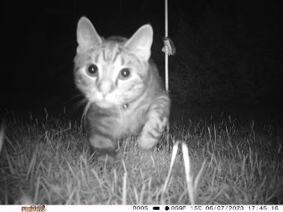
2023 Mid-Year Report: Community Cat Program / Ecology study - Camera Tracking of Cats and Wildlife
Estimated time required to process data from camera deployments
Round | Deployed | Suburbs | Clean (hr) * | ID (hr) ** | Total (hr) | Weeks ***
1 | Jun – Sep 2020 | Rosewood | 12 | 137 | 149 | 30
 |  | Goodna | - | - | - | -
 |  | Redbank Plains | 9 | 101 | 110 | 22
2 | Dec 2020 – Apr 2021 | Rosewood | 18 | 200 | 218 | 43
 |  | Goodna | 7 | 78 | 86 | 17
 |  | Redbank Plains | 15 | 164 | 179 | 35
3 | Aug – Nov 2021 | Rosewood | - | - | - | -
 |  | Goodna | - | - | - | -
 |  | Redbank Plains | - | - | - | -
4 | Feb – Apr 2022 | Rosewood | - | - | - | -
 |  | Goodna | - | - | - | -
 |  | Redbank Plains | - | - | - | -
5 | Jun – Aug 2022 | Rosewood | - | - | - | -
 |  | Goodna | - | - | - | -
 |  | Redbank Plains | - | - | - | -
6 | Jan – Mar 2023 | Rosewood | - | - | - | -
 |  | Goodna | - | - | - | -
 |  | Redbank Plains | - | - | - | -
7 | Jun – Sep 2023 | Rosewood | 2 | 25 | 27 | 5
 |  | Goodna | 2 | 21 | 23 | 5
 |  | Redbank Plains | TBA | TBA | TBA | TBA
This study has two aims. Firstly, to evaluate the effect of our CCP on free-roaming cat numbers in 3 suburbs, and secondly, to determine if native wildlife density & diversity is associated with the number of free-roaming cats.
7 rounds of data collection have been completed – 50 cameras are sequentially placed in 3 suburbs for 2 weeks every 6 months.
Data processing is complete for rounds 3-6 & is in progress for rounds 1, 2 and 7.
Improvements in deployment method has reduced the volume of data by several hundred thousand images per deployment.
New software used to sort images by contents has reduced cleaning time by ~50%.
* Based on an estimated speed of 300 images per minute, calculated based on the average real speed of cleaning the images post-auto sorting by the modified MegaDetector software.
** Based on an estimated speed of 5 images per minute, calculated based on the average real speed of identifying the species in the images on the Camelot software.
*** based on 8 hours per week of work

Slide 13
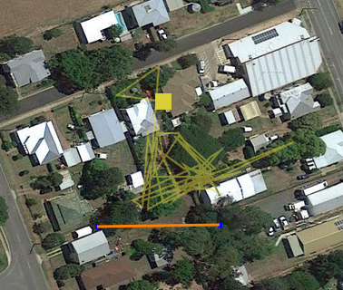
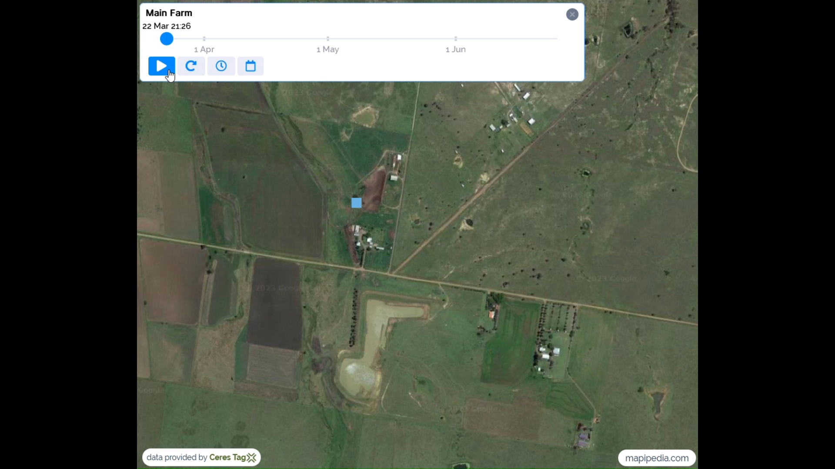
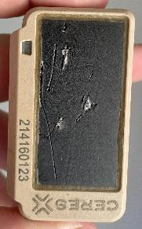
2023 Mid-Year Report: Community Cat Program / Ecology Study: Tracking of cat movements following desexing of cats at multi-cat locations where cats are being cared for caregiver (semi-owners) under DAF permit.
50 m
500 m
“Indestructible” tracker damaged by cat
Cat tracked at multi-cat site in Jul – Sep 2023. Note limited range of cat from food source
Cats tracked at a dairy farm in Mar-Jun 2022
CLICK ON IMAGE & THEN CLICK PLAY ICON TO SEE THE CATS’ MOVEMENTS
NB. Orange line coming in from northeast is not associated with a cat – tag was delivered by car that day
The aim of this study is to document the home range of cats covered by our Restricted Matter Permit (DAF). These cats are desexed & microchipped, but remain semi-owned and cared for by a designated carer. APWF contact details are on the microchip database. The aim is to determine if these cats relocate to forest and become feral after desexing. Answer = NO
Middle image shows one cat at a multi-cat site (from 20 July–11 Sep 2023). The cat did not roam far (mostly less than 50m).
Tracking at a dairy farm from 22 Mar–25 Jun 2022 showed cats mostly roamed between buildings on the farm and remained within 500 meters of the dairy (food source). Click on image and then play icon to view movements. Yellow cat is house cat.
On a technical side, the performance of the Ceres tracking tags has been disappointing, often running out of charge earlier than expected or not transmitting data, and one tag was damaged while in use, and is now unusable (value approx. $600).

Slide 14
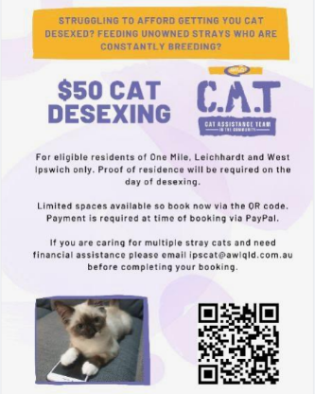





2023 Mid-Year Report: Community Cat Program / Top Performing Facebook Posts

Slide 15
2023 Mid-Year Report: Community Cat Program / Advocacy
National , State and Local Government Advocacy:
National government:
Australian Federal Parliament – The Worsening Rental Crisis in Australia Senate Inquiry Submission
State governments:
New South Wales Government – Keeping Pets in Residential Tenancies
New South Wales Parliament – Veterinary Workforce Shortage in NSW Inquiry Submission
New South Wales Parliament – Pounds in NSW Inquiry Submission
South Australia Government – Residential Tenancies Review
Victoria Government – Rehoming Pets Reforms
  Attended 3 workshops (2 x Jacquie, 1 x Jade) and submitted a 14-page survey
Queensland Government – Strong Daw Laws: Safer Communities Submission
Local governments:
City of Greater Dandenong (VIC) – Cat Curfew Consultation
  Submission of questions to council meetings and emails to Mayor and Councillors
Indigo Shire (VIC) – Cat Curfew Consultation
Geelong council (VIC) – Cat Curfew Review submission
West Torrens Council (SA) – Draft Domestic Animal Management Plan Merri-bek City Council (VIC) – Cat Containment Strategy
Blacktown Council (NSW) – Cat Management Document
City of Greater Bendigo (VIC) – Proposed Cat Orders
Sunshine Cost Council (QLD) – Proposed Cat Local Law
Hume Council (VIC) – Draft Domestic Animal Management Plan 2023-2026 submission
Print/Online Media
Companion Magazine (Published by the ASAV on a quarterly basis)
  Republished conversation article titled “It’s Time For Change. Why Euthanising Australia’s Stray Cats Isn’t Solving The Problem.”
Vet Practice Magazine (A monthly print and online ‘zine that is distributed to animal health practitioners and clinics across Australia)
  Published an article on crisis in sheltering and cost of living increases
International Cat Care
  Republication of article titled “Managing Cats in Australia from Wellbeing International”
Sydney Morning Herald & The Age
  Publication of article titled “Claw and order: Are Cats Villains or Victims in the War on Feral Animals?”
Radio & TV Interviews
FiveAA AM (South Australia)
ABC Newcastle (Norris)
ABC Queensland Drive Time
7.30 Report ABC (TV)
Presentations
Blacktown City Council Forum (Councils Unite for Pets)
National Domestic Cat Management Working Group
Lane Cove Council Meeting
Animal Welfare League, NSW – Board and staff
Animal Welfare League, SA – CEO and staff
Hon Thompson, MP Davenport SA
ANZCVS Science Week
HSUS – Expo (USA) – 2 presentations

Slide 16
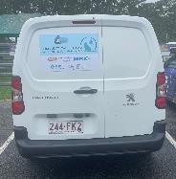
2023 Mid-Year Report: Community Cat Program
I would like to thank all our partners and donors for their invaluable support of the project. Also, thanks to supporting veterinary clinics and cat lovers.
A special thanks to our passionate and dedicated Community Liaison officer, Nadia Scott, seconded and funded by RSPCA Qld, and to the slick and polished RSPCA desexing team of vets and vet nurses.
With our partners support, we are building knowledge about humane urban cat management, and sharing that information with local, state and federal governments, welfare agencies and the community.
Community Cat Programs are aligned with the One Welfare concept which aims to balance and optimize the wellbeing of animals, humans and the environment.
Jacquie
Emeritus Professor Jacquie Rand, BVSc (Melb), DVSc (Guelph), MANZCVS
Diplomate, American College of Veterinary Internal Medicine
Executive Director & Chief Scientist
Australian Pet Welfare Foundation
Working to improve the health and welfare of pets
Partners in 2022-23
Bridgette Bardot Foundation
MSD Animal Health
RSPCA (QLD)
AWL Qld
RSPCA NSW
Pets Regardless Foundation
PetRescue
Cat Protection Society NSW
Neighborhood Cats USA
Sydney Dog and Cats Home
Cheltenham Cat Rescue
Maneki Neko Cat Rescue
Ipswich City Council
Department of Agriculture and Fisheries (Qld)
Dr John Boone (Great Basin Bird Observatory)
Waltham Foundation

